Slide 1

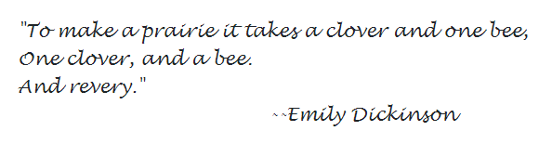




The Bank Where Service Never Ends

Slide 2
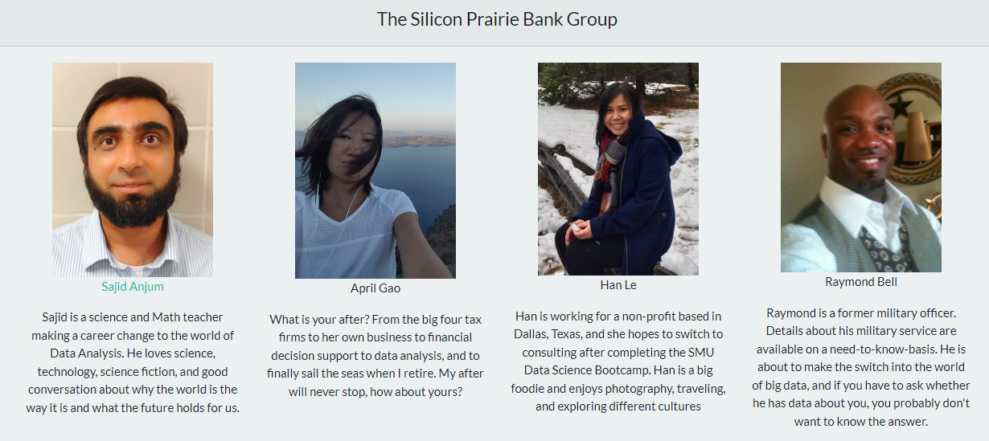

Slide 3
Introduction

Slide 4
Twentieth Century Banking
Prior to the advent of modern banking, loans were only accessible to a select and connected elite.
The development of the Federal Reserve, ATMs, credit cards, and internet banking has allowed banking and financial services to be accessible to the majority of the American population
Stability without centralization is the goal of a dynamic and prosperous final system, and this is only possible if banks can make good decisions that minimize risk.

Slide 5
We created two machine learning models and a web app to deploy them
How Can We Make Banking Better?
The first model helps us to predict whether an applicant will default on their credit card
The second model helps banks to predict whether an applicant will default on their personal loan.
We hope that helping banks make better decisions will allow them to customize credit cards and loans for every single applicant.

Slide 6
Data Processing and Machine Learning

Slide 7
Data Sets
We obtained both of our datasets from Kaggle
Our credit card data set was a dataset of customers in China who had applied for a credit card
The dataset was very clean with no null values, binary columns already encoded as 0s and 1s, and numerical columns in appropriate datatypes.
We dropped three columns

